Slide 1

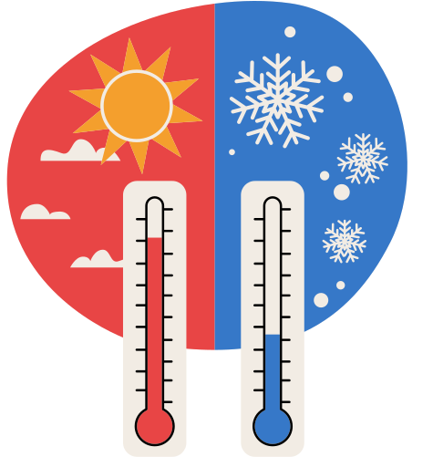
WEATHER PREDICTION WITH MACHINE LEARNING

Slide 2
INTRODUCTION
Weather prediction is the use of science and technology to predict the atmospheric condition of a given area and time
weather forecasts are made by collecting information bout the
current state of the atmospheric in a particular area and then using
the weather to predict how the atmosphere will change

Slide 3



TOPIC DESCRIPTION
Data collection
Data processing
Data cleaning
Train & Test model
Predict weather

Slide 4

WEATHER
PREDICTION
USING MACHINE LEARNING
Temp
outlook
wind
humidity
play

Slide 5

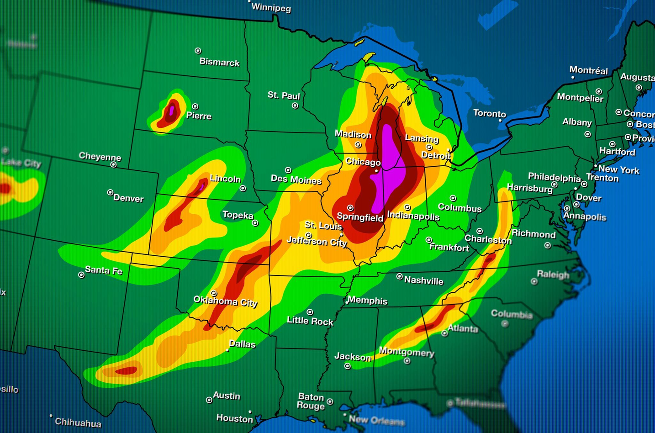
Thank's
For Watching
priti singh

